Slide 1
‘Least Cost Location Theory’
By
Alfred Weber
Dr. Kaustuv Mukherjee
Asstt. Prof. in Geography
Chandidas Mahavidyalaya

Slide 2
Introduction:
Proposed by : Alfred Weber of Germany
Year: 1909
In his Book: “Theory of the Location of Industries” (Uber den Standort der Industrien)
His book is translated in English in 1929 and after that this concept became popular.

Slide 3
Objectives:
To find out the minimum cost location for Industrial set up based on three factors –
Transport Cost
Labour Cost &
Agglomeration Economies

Slide 4
Assumptions:
Isotropic Physical and Socio- Economic Landscape
Perfect Competition Market
No Scarcity of Demand
Static labour Position
Uniform and Proportionate Cost Structure
The Entrepreneurs seek to minimize cost
Uneven Distribution of Natural Resources

Slide 5
Principles
Transport Cost Principle
Labour Cost Principle
Agglomeration Economies Principle

Slide 6
Transport Cost Principle
Material Index (MI) $=\frac{\text{Weight} \text{of} \text{Raw} \text{Material}}{\text{Weight} \text{of} \text{Finished} \text{Product}}$
Example:
Raw Material (Iron Ore) = 5 ton
Finished Product (Steel) = 3 ton
MI = 5/3 = 1.67
If,
MI is > 1 means Weight Loosing Industry
MI = 1 means Pure or Foot Loosing Industry

Slide 7
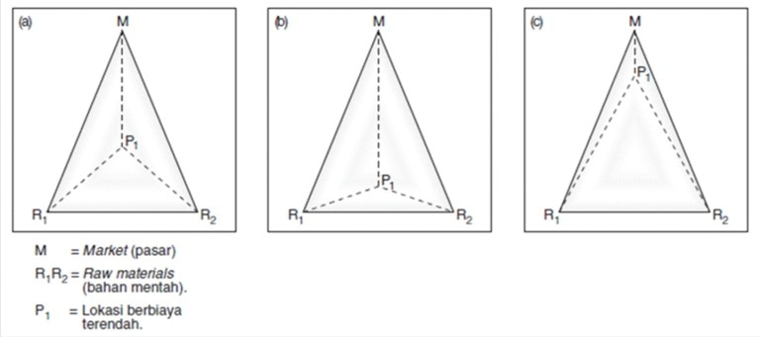
Linear Location
Non- Linear Location ( Triangle)

Slide 8
Labour Cost Principle
According to him, Some regions have cheap labour availability. So, an industrialist can shift his industry from initial location to cheap labour cost location.
Condition:
When savings for Cheap Labour > Extra Transport Cost for Shifting location

Slide 9
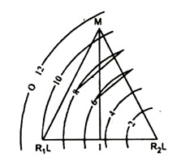
Isotim:
The line joining the places of equal transport cost (raw material cost or cost of delivery).
Isodapane:
The line joining the places having equal total cost.
Total Cost = Raw material Cost + Delivery Cost
Critical Isodapane:
The line joining the places where savings for labour is equal to extra transport cost is called as Critical Isodapane.
This is the critical line beyond which no industry will go for industrial set up.

Slide 10
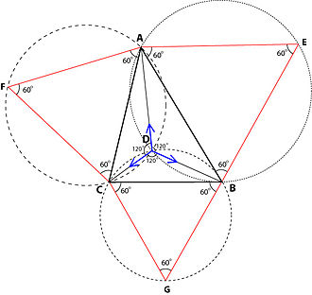
Agglomeration Economies Principle
Association of some industries in a particular location can attract an Industry from least cost location perspective.
Due to the availability of facilities like security, economy, total cost etc. Industry can be set up in agglomeration areas.
It will take place in the common areas of their Critical Isodapanes.

Slide 11
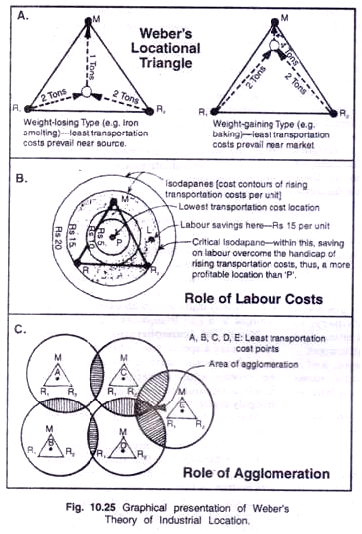

Slide 12
Criticism:
Criticise the assumptions.

Slide 13
Thank You

